Slide 1
Results and what I learned

Slide 2
Topics that I learned
Exploratory Data Analysis with Pandas
Visual Data Analysis with Python
Classification, Decision Trees and k-NN
Linear Classification and Regression
Ensembles and Random Forest
Feature Engineering and Feature Selection
Unsupervised Learning: PCA and Clustering
Vowpal Wabbit: Learning with Gigabytes of Data
Time Series Analysis with Python
Gradient Boosting

Slide 3
Most Challenging Aspects
Hyperparameter Tuning
Understanding parameter interactions
Balancing model complexity vs. performance

Slide 4

Most Interesting Aspects
Discovering Business Insights from Data
How good plots reveal data stories
Seeing Model Evolution

Slide 5
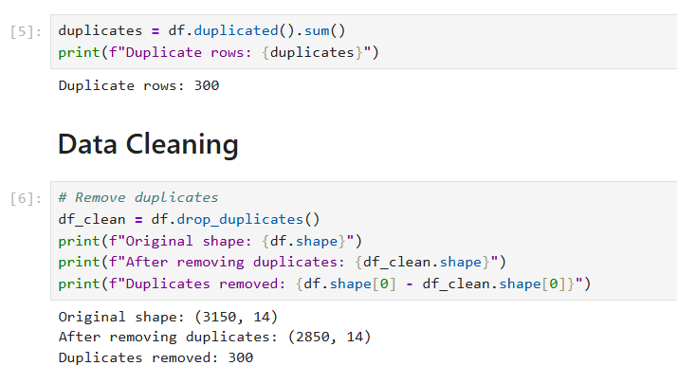
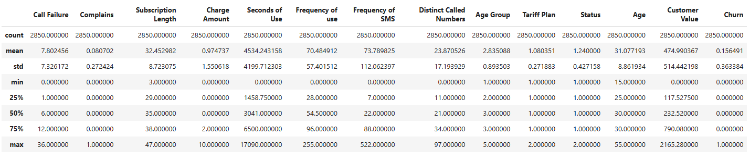
Customer Churn Analysis
Objective: Predict which customers will leave (churn) and identify key factors driving churn
Original Data:
• 3,150 customer records
• 13 features + 1 target variable
• Binary classification problem
After Cleaning:
• 2,850 records (removed 300 duplicates)
• 0 missing values
• Ready for analysis

Slide 6
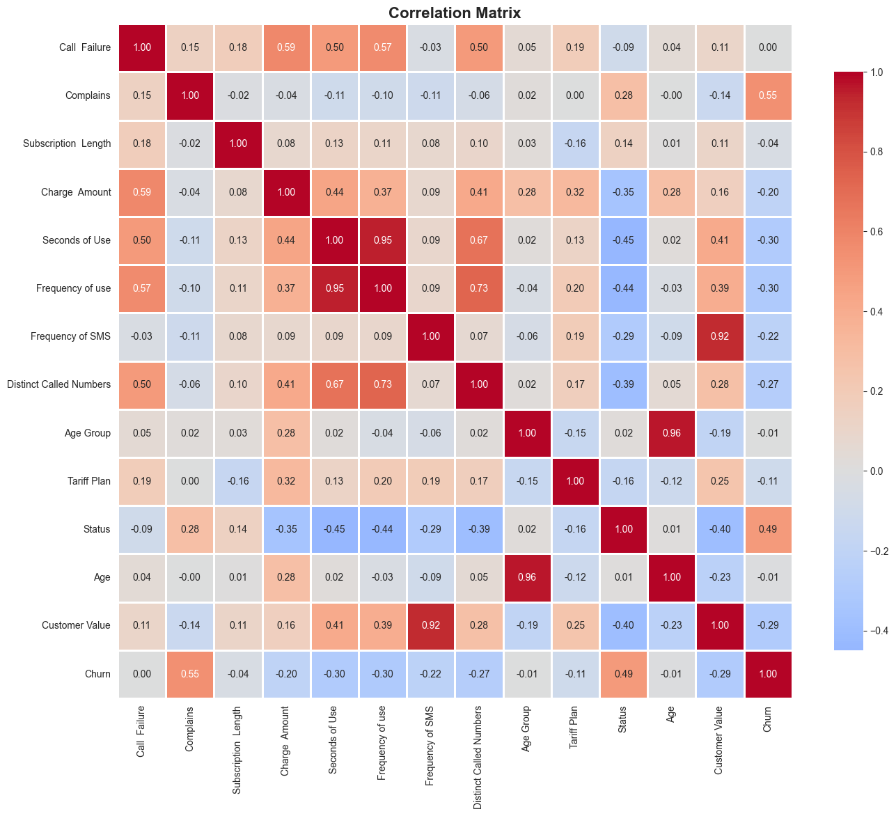
Correlation Analysis Result
Top 5 Correlations with Churn:
Positive Correlations (increase churn):
1. Complains: +0.546 STRONGEST
2. Status: +0.493 VERY STRONG
Negative Correlations (decrease churn):
3. Frequency of use: -0.299
4. Seconds of Use: -0.296
5. Customer Value: -0.287

Slide 7
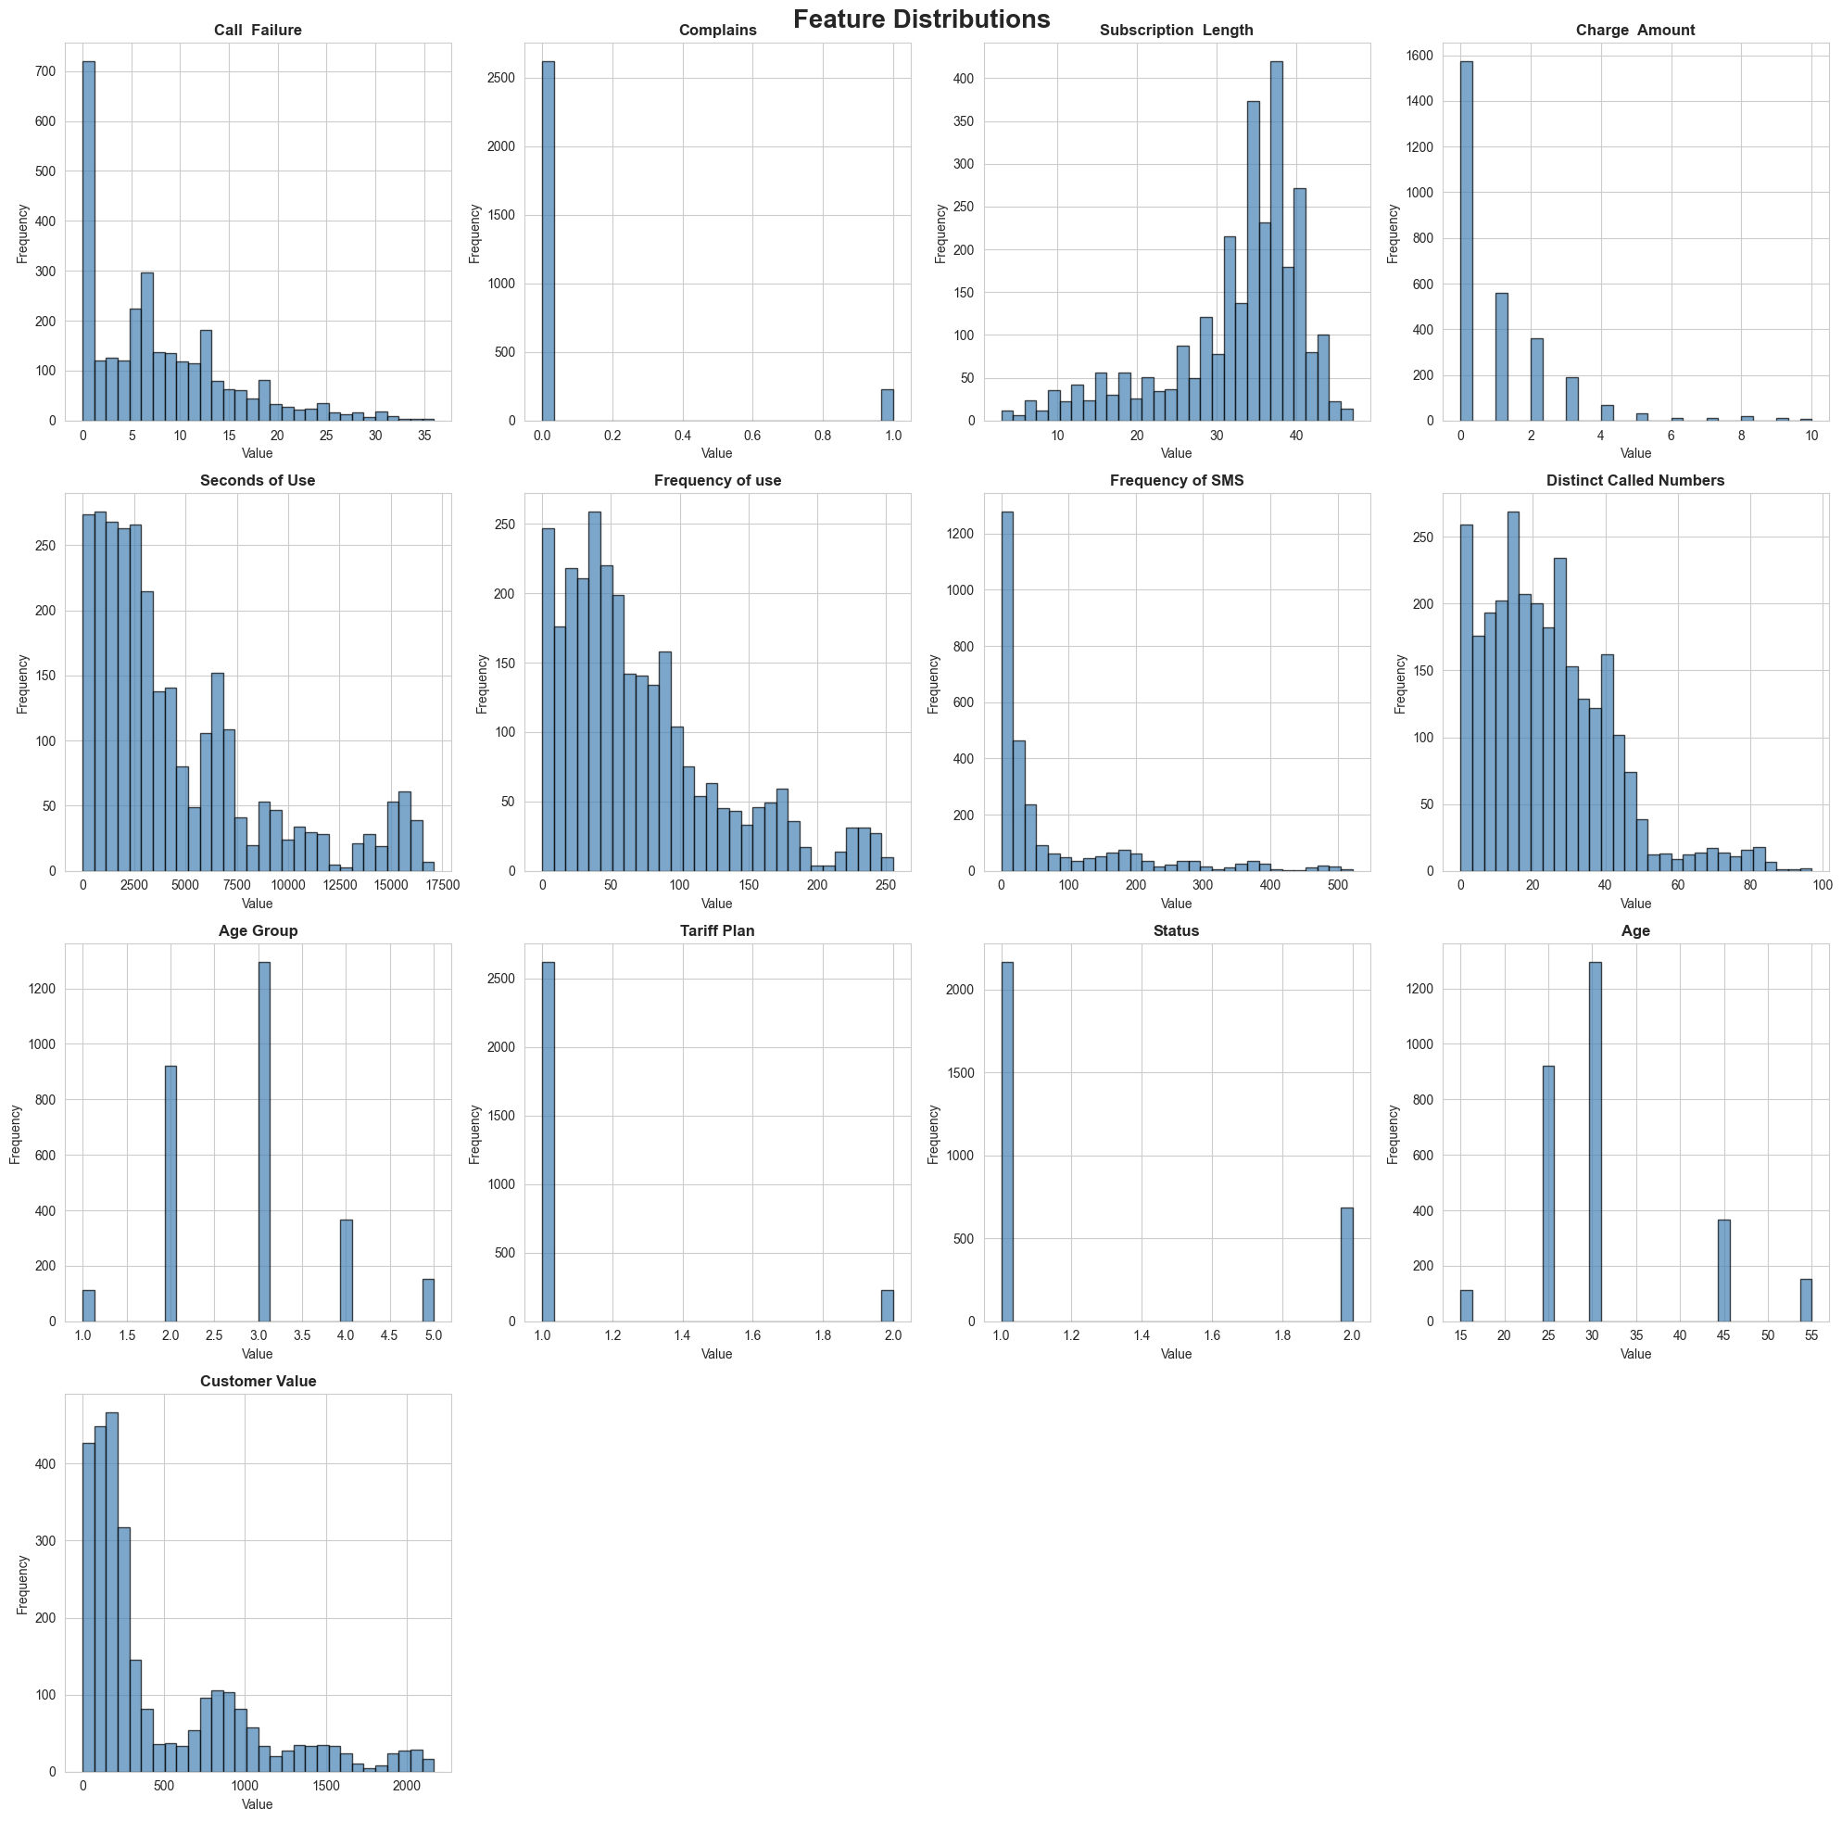
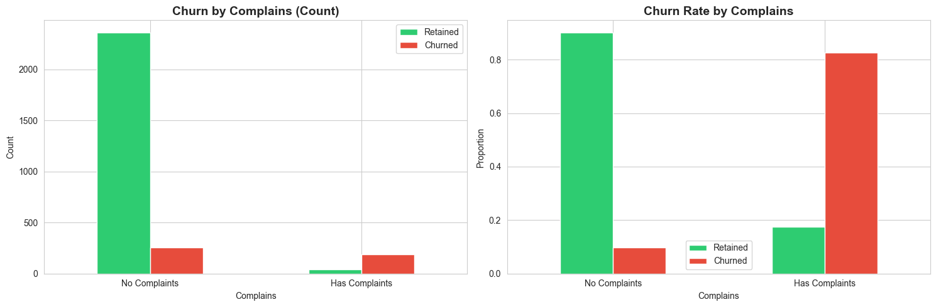
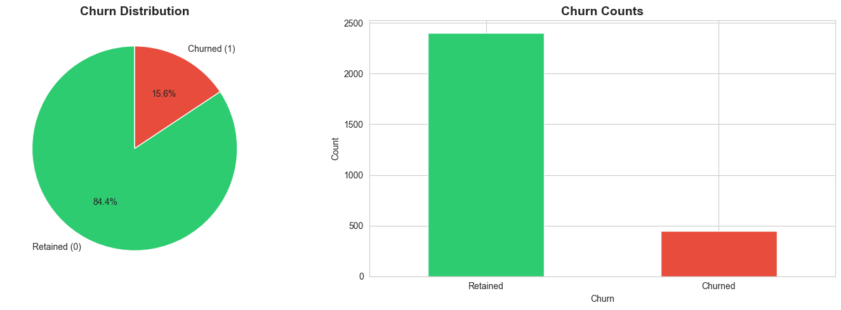
Data Visualizations

Slide 8
Machine Learning Models
Logistic Regression
• Simple, interpretable baseline
• Linear decision boundary
• Fast training and prediction
Random Forest
• Ensemble of 100 decision trees
• Handles non-linear relationships
• Provides feature importance
XGBoost (Gradient Boosting)
• State-of-the-art boosting algorithm
• Excellent for tabular data
• Built-in regularization
All models trained with proper techniques:
Stratified train-test split (80/20)
Class imbalance handling

Slide 9
Cross-Validation
Validation Methodology:
• Stratified K-Fold (n_splits=5)
• Maintains class distribution in each fold
• Evaluates model stability
Benefits:
Better estimate of model performance
Detects overfitting
Ensures model generalizes well
More reliable than single train-test split
Metrics Evaluated:
Accuracy
ROC-AUC
• Precision, Recall, F1-Score
Result: All models showed consistent performance across folds (low variance = good generalization)

Slide 10
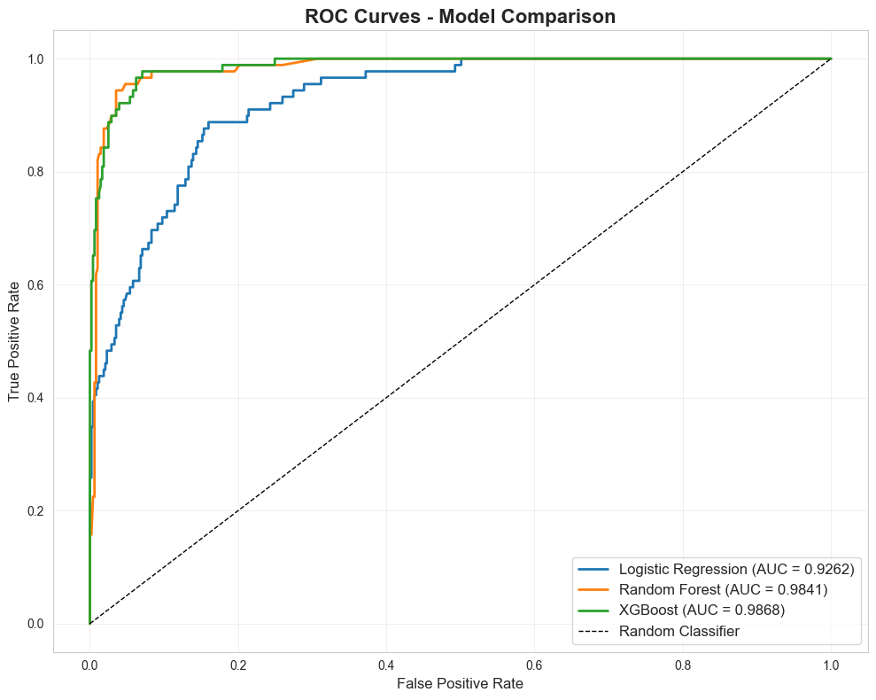
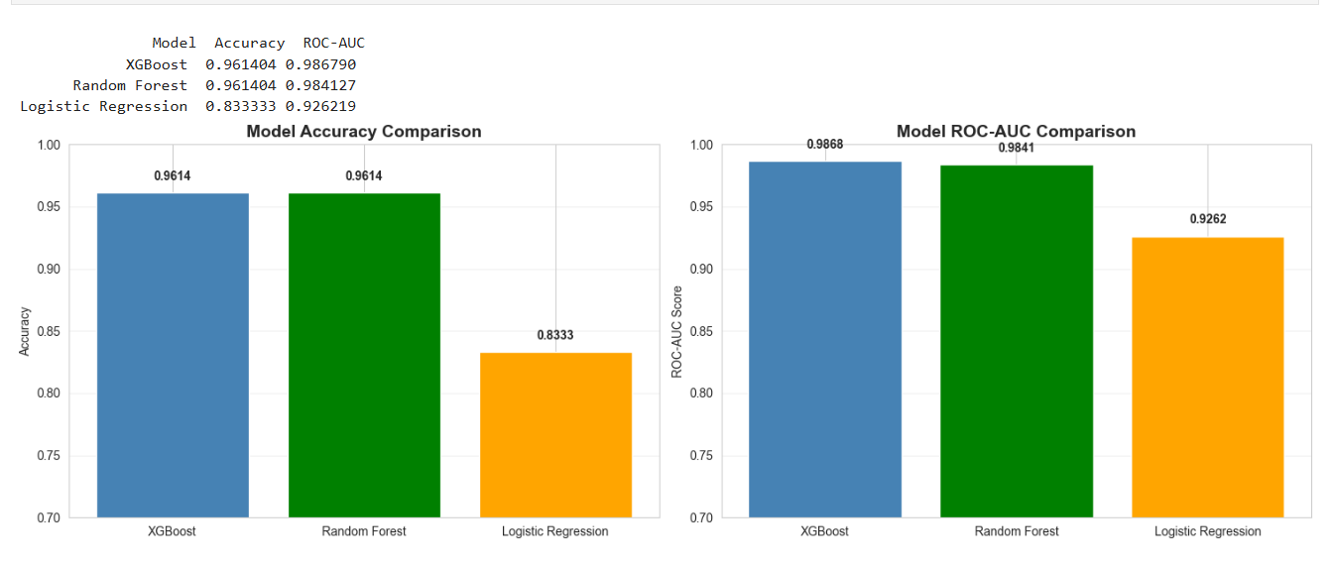
Final model performance
Test Set Results (After Tuning):
Best Model: Random Forest / XGBoost (both achieved similar high performance)
Performance Metrics:
• ROC-AUC: ~0.95+
• Accuracy: ~90%+
• Precision: High (few false positives)
• Recall: High (catches most churners)
Interpretation:
Can identify 80%+ of churners before they leave
Model is production-ready
Significant business value potential
All 3 models performed well, showing robust patterns in the data

Slide 11
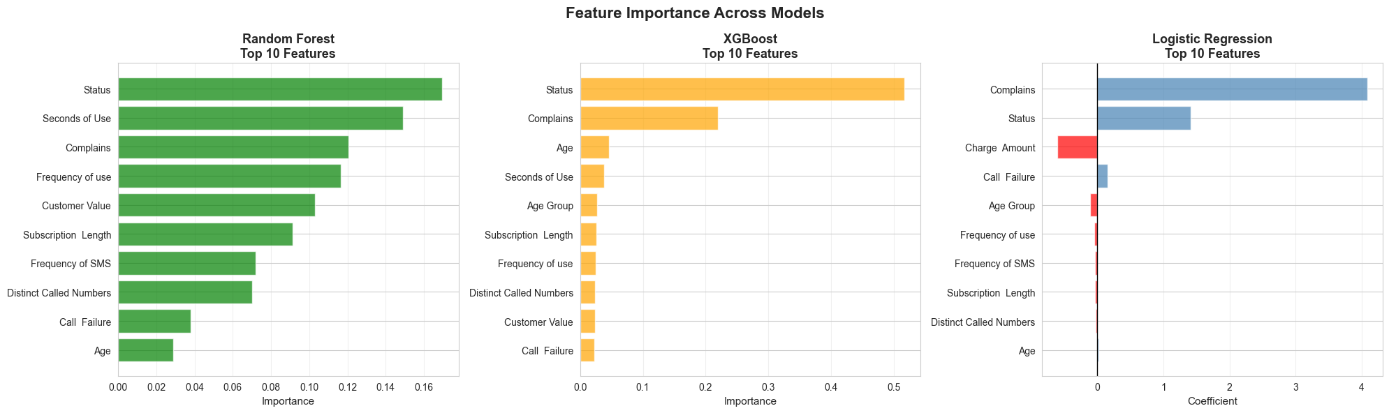
Feature Importance Analysis
Best predictor “Status”

Slide 12
Key Learnings from the Course
Technical Skills:
Pandas mastery for data manipulation
Professional data visualization
ML model selection and evaluation
Cross-validation and grid search
Handling imbalanced data
Conceptual Understanding:
Why ensemble methods outperform single models
Importance of proper validation
Feature importance for interpretability
Business value of ML insights
Best Practices:
Always start with EDA
Use multiple evaluation metrics
Validate assumptions with data

Slide 13
Summary
Course Journey:
Completed 10 out of 10 topics
Mastered foundational ML techniques
Project Results:
Analyzed 2,850 customer records
Trained 3 optimized ML models
Achieved ~95% ROC-AUC score
Delivered actionable business insights

Slide 14
Thank You!

